Slide 1

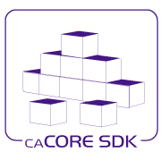

NCICB
Open Source Modeling Tool Support
Satish Patel
March 05, 2007
Ekagra Software Technologies Ltd.

Slide 2
Scope
Release 4.0 Scope
  There is a new requirement for the SDK 4.0 release to be able to perform code generation based on XMI generated by an open source modeling tool. The scope has impacts on SIW and caAdapter products which should also be enhanced to process XMI from the chosen open source tool with the same functionality as XMI received from Enterprise Architect.

Slide 3
Open Source Tool
Stakeholder Definition of Open Source Tool
  The source and binary must be freely available for users to download and use. The tool can be an "open source" tool provided by a commercial entity; but it should not be a a "community edition" or an "evaluation" copy.

Slide 4
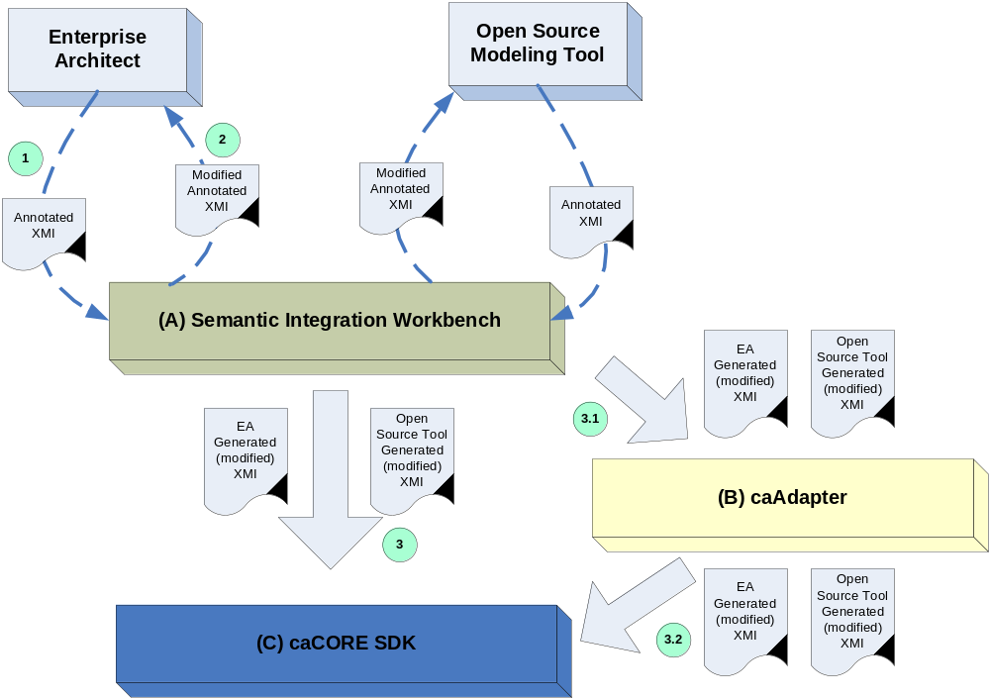
NCICB Product Touch Points

Slide 5
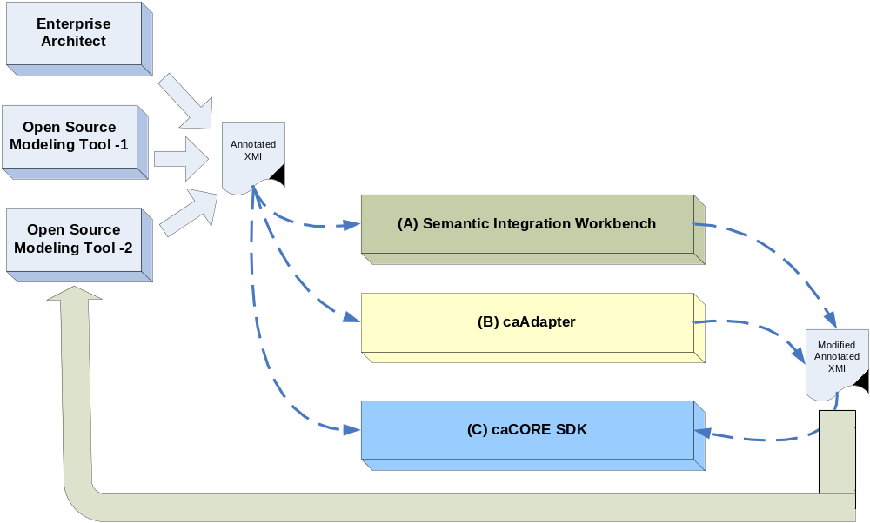
NCICB Product Touch Points

Slide 6
Short List of Tools
Open Source
  ArgoUML:
    Has commercial extensions as Poseidon and MyEclipse UML Modeling tools
  HyperModel
    Has been completely rewritten using the Eclipse UML2 and XSD libraries and the Eclipse Modeling Framework (EMF)
    Interoperable with IBM's RSM/A 6.0 since they use the same file format; both are based on the Eclipse EMF and UML2 projects.

Slide 7
Short List of Tools cont’d
Community Edition Tools
  Poseidon: Free for 1 year for open source projects
  Magic Draw: Allows minimal set of features enabled and only allows full functionality for class diagrams. All other diagrams are read only.

Slide 8
Evaluation Criteria
Open Source
Must support XMI version 1.1, 2.0
Must support UML version 1.3
Future support for UML 2.0
Must be able to import/export XMI
Interoperability amongst other UML tools
Documentation
Operating Systems: Windows, Linux, Mac
Must Support Activity, Sequence diagrams
Significant user base/developer support

Slide 9
Tasks/Responsibilities
Elaboration
  Evaluation (caCORE SDK)
    Evaluate short listed tools against criteria
      Maybe existing evaluations already done
    Present evaluation and recommendation to group for review.
    Finalize on Open Source tool.
  Design
    Satish/Christophe work together on design for supporting new tool . (SDK/SIW)
    Present design to group (SDK/SIW/caAdapter) for comments
    Revise design and present for final approval (SDK)
    Prototype - Build caCORE SDK test model with identified tool (SDK)
  Evaluate development effort/timeline based on design outcome.
    Revise Task Plans (All teams/Product Managers)

Slide 10
Timeline
Open Source UML Tool Selected – 3/16
Build caCORE Test Model – 3/21
Finalize Design – 3/28
Evaluate LOE/Revise Task Plans for Construction – 4/4

Slide 11
Questions????

